Slide 1
01 | Credit Risk Modelling-Overview
02 | Approach/ Architecture
03 | Exploratory Data Analysis
04 | Feature Selection
05 | PD, LGD & EAD Modelling
06 | Conclusion
Table of contents

Slide 2
Credit Risk Modelling Overview
Mortgage house loans were made available to borrowers with low creditworthiness (those with low credit scores) during the US recession of 2008. A person with a low credit score is more likely to fail on a loan, making them a dangerous customer for the bank. If present and future credit losses are not discovered or forecasted appropriately, then it would lead to loss.
Credit risk modelling allows the banks to predict whether a customer will be able to repay their loan by analyzing the previous history and credit reports of the customer. The credit risk analysis helps to calculate a risk score for each individual case.
Then the bank decides whether to sanction the loan or not depending upon the risk score value. AI and machine learning technology can alert the bank to warning signs and inconsistencies that could indicate inaccurate data or other underwriting errors.
Advanced data analytics also can streamline the entire underwriting process by automating many manual tasks while reducing the likelihood of human errors or bias creeping into the process.

Slide 3
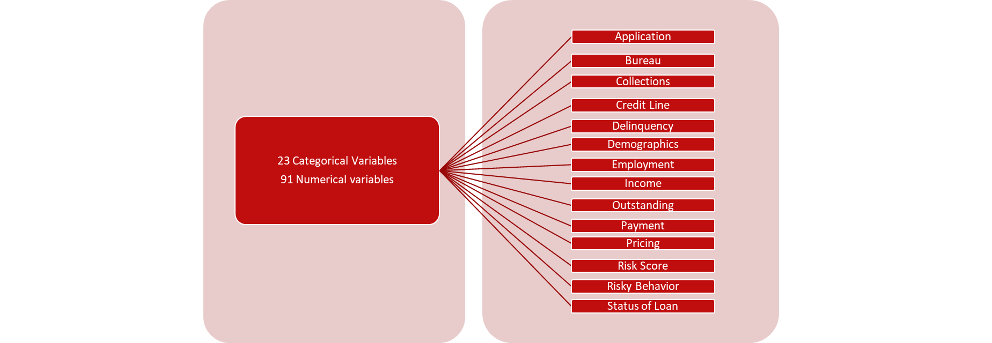
Credit Risk Modelling Overview
Data set: Lending club dataset from Kaggle is used for the use case, This data set represents thousands of loans made through the Lending Club platform
Description: The size of the data is (approx. 2.8 million observations), so performed stratified sampling with respect of target variable (loan status), now the shape of data is (731373, 142)
There are 23 categorical variables and 91 are numerical.

Slide 4
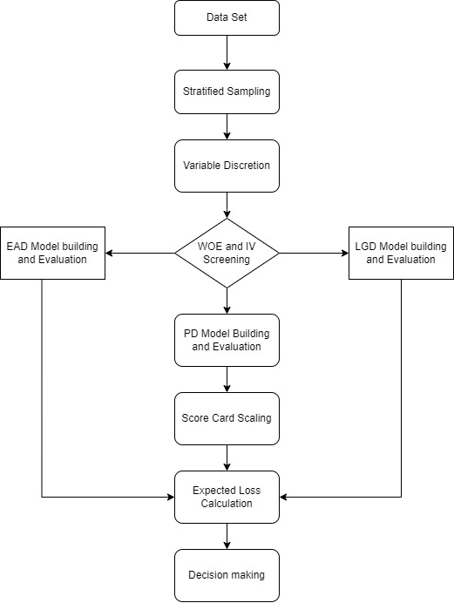
Credit Risk Modelling Overview
Internal ratings-based (IRB) models to calculate regulatory capital for credit risk. Internal ratings-based (IRB) models currently used by institutions to calculate regulatory capital requirements for credit risk.
ML process using algorithms rather than procedural coding that enables learning from existing data to predict future outcomes which covers a wide range of models with different levels of complexity.
It has four credit risk components :
Probability of Default (PD)
Exposure at Default (EAD)
Loss given Default (LGD)
Expected Loss

Slide 5
Approach/ Architecture
Data Preprocessing
Feature Selection
Splitting Data
Train/Test
Choosing a Model
Probability of Default:
an estimate of the likelihood that the borrower would default.
Loss given default:
the share of an asset that is lost if a borrower defaults.
Exposure at default:
the total value that a lender is exposed to when a borrower defaults.
Logistic Regression
used
Linear & Logistic
Regression
Linear & Logistic
Regression
Expected loss : EL = PD × LGD × EAD = PD × (1 − RR) × EAD

Slide 6
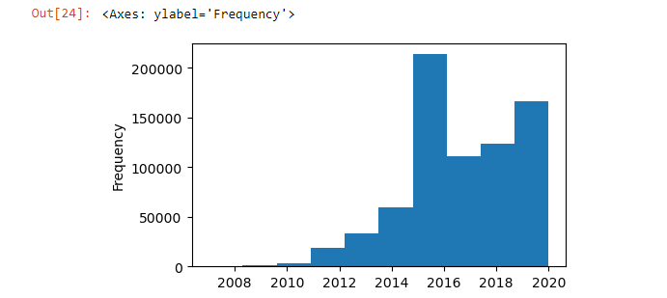
Exploratory Data Analysis
Missing Value Detection & Treatment:
29 columns having more than 90% missing values have been removed.
For other columns, we have used two approaches.
Replace the missing values with the mean of the non-missing values of the variable.
For some variables, replaced the missing values with zeroes
Significant Variables in our Database
Continuous Variable
Emp_length
Earliest_cr_line
Term
Issue_d
Discrete Variable
Grade
Home_ownership
Verification_status
Purpose
Addr_state
Target Variable: loan_status
Out of 10 categories, we have made this variable as an indicator. (0 & 1)
The Imbalance ratio is 6.75.
Lending club loan has started in 2008 so gradually it picked up over years.

Slide 7
Feature Selection
A feature is an attribute that has an impact on a problem or is useful for the problem, and choosing the important features for the model is known as feature selection.
The huge amount of data also slows down the training process of the model, and with noise and irrelevant data, the model may not predict and perform well. So, it is very necessary to remove such noises and less-important data from the dataset and to do this, and Feature selection techniques are used.
Filters Method
Supervised
Feature Selection
Feature Selection Methods
Embedded Method
Unsupervised
Feature Selection
Wrappers Method
For selecting the features, we have used 2 key concepts: WOE and IV

Slide 8
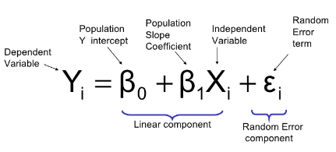
PD Model Building: Probability of default
STEP 1
Data Exploration and Cleaning
STEP 2
Data Transformation — Weight of Evidence Method
STEP 3
Feature Selection using Information Value
STEP 4
Model Fitting & Interpreting Results
We have our target variable loan as an indicator
Why logistic regression and logistic regression will help us in calculation of PD?
High Annual Income – lesser probability of default
Low Annual Income – higher probability of default
Credit Scorecard
Good/ Bad | Home: Owned | Home: Rent | Grade : A | Grade : B | Term:36 months | Term:60 months
0 | 0 | 1 – 30 | 0 | 1- 60 | 1 – 70 | 0
0 | 1 – 50 | 0 | 1 – 80 | 0 | 0 | 1- 50

Slide 9
The borrower’s credit score depends on
Residence - Owned/ Rent
Mortgage Status
Fico score
Employee length
Term (duration of loan) etc.
PD
Score
1% | 850
2% | 769
3% | 711
4% | 689
6% | 613
7% | 530
8% | 455
10% | 411
Very few
Significant
Common
Very Common
Very Common
Common
Significant
Very few
Variable score=
(max score –min score)
(max sum coef –min sum coef)
variable coef
300-450
450-600
600-750
750-850
Bad Fair Good Excellent
Cutoff Rate : Used for taking a decision whether to approve a loan application or not.
Apart from probability of default, we also have False negatives(predicted default but they don’t)
And False positives(predicted to pay but defaulted). In both cases, our model fails to predict which affect the profitability of bank badly.
Setting cutoffs is very important.

Slide 10
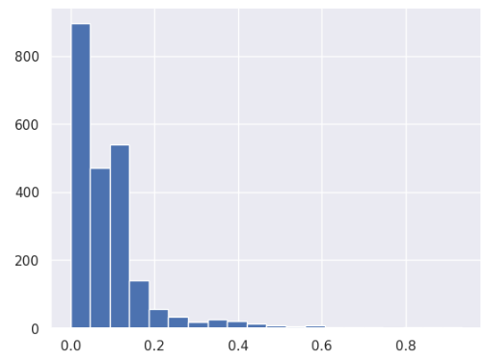
LGD Model Building: Loss given default
The percentage of total exposure that can not be recovered by the lender once the default has occurred
LGD (as percentage)=
1 - (Potential Sale Proceeds / Outstanding Debt)
We have our target variable derived from recovery rate and EAD
Here we take a two-step approach
Is the recovery rate equal to 0 or greater than zero [Classification]
If the recovery rate is greater than zero, how much exactly it is [Regression]
Loan Amount | Amount Repaid | Outstanding Balance | EAD if default | Recovered | LGD
400000 | 100000 | 300000 | 300000 | 200000 | 1 - (200000/300000) = 33.3%
1000000 | 400000 | 600000 | 600000 | 400000 | 200000/ 600000 = 33.3%

Slide 11
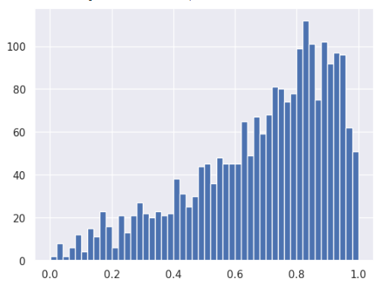
EAD Model Building: Exposure at default
The entire amount that a lender is exposed to in case of failure by a borrower
We have our target variable derived from funded amount and total principal recovered
To predict EAD for a customer regression model is used
Loan Amount | Amount Repaid | Outstanding Balance | EAD if default
400000 | 150000 | 250000 | 250000
1000000 | 400000 | 600000 | 600000

Slide 12
Conclusion
For every loan record, we have calculated an expected loss.
Funded amt | PD | LGD | EAD(amt) | EL(amt)
2400 | 0.23068 | 0.91948 | 1579.93 | 335.11
Similarly, bank can calculate total funded amount and total expected loss for their portfolio and see how much percentage of total funded amount is the expected loss.
The percentage of Total Expected loss/ Total funded amount
Calculation of Expected loss:
•Helps lender estimate potential losses.
•Plays a crucial role in determining capital requirements.
•Influence the pricing of loans
•Helps lender evaluate the loan portfolio
•Support Regulatory Compliance

